Slide 2
General remarks
Request for free access to information sent to 23 municipalities
Question was related to amounts that are allocated by municipalities for free textbooks in previous three school years (2014/15, 2015/16 and 2016/17)
Response was submitted by 18 local self-governments, i.e. 16 municipalities, the Capital City and the Royal Capital
Response was not submitted by 5 municipalities: Budva, Bijelo Polje, Plav, Rožaje and Gusinje

Slide 3
How much funds have municipalities allocated for free textbooks?
Of 18 local self-governments that have submitted their answers, 14 stated that they had costs on the basis of providing free textbooks in all previous three school years, for which CCE asked information
In last three years from the budgets of local self-governments EUR 689,679.02has been allocated
Thus, 14, 360 sets of books for pupils of different grades in elementary schools in Montenegro were ensured

Slide 4
How much funds have municipalities allocated for free textbooks?
Two municipalities did not have costs on this basis - (Andrijevica and Pljevlja);
Three municipalities have been allocating funds for free textbooks continuously since 2014/15 - (Berane, Plužine and Podgorica);
Three municipalities have been allocating funds since 2015/16 school year and these are - (Bar, Herceg Novi and Petnjica);
Even 10 municipalities that have submitted data, introduced this practice only in this election year (Danilovgrad, Žabljak, Kolašin, Kotor, Mojkovac, Nikšić, Tivat, Ulcinj, Cetinje and Šavnik);

Slide 5
The amount of funds allocated for free textbooks per municipality

Slide 6
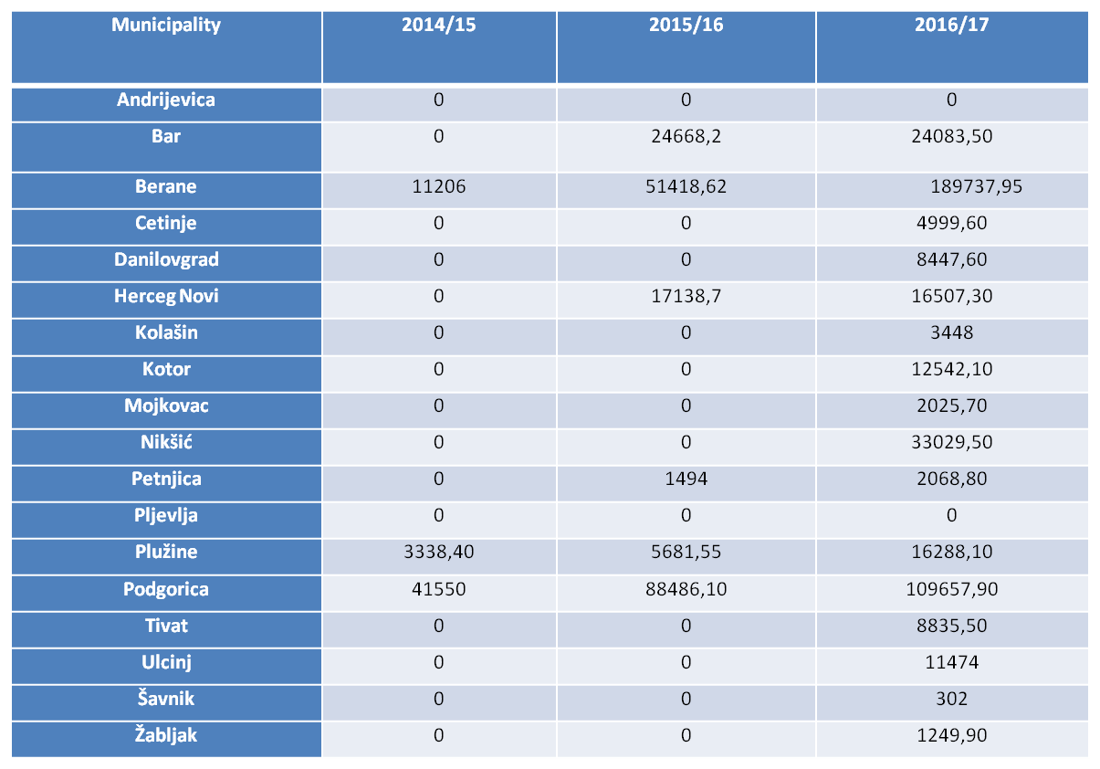
Amount allocated for free textbook per year

Slide 7
OVERVIEW
When it comes to total sum for all years, municipality Berane is leading, having a continuity in addressing the issue of free textbooks, including a step forward which this year was made in the part that textbooks were provided not only for first graders but for all elementary school pupils. It is followed by the Capital City of Podgorica. However, the abrupt growth was noted in municipalities of Nikšić, Plužine, Ulcinj, Danilovgrad, Tivat, Cetinje and Žabljak.
Growth of allocated funds is visibly significant when comparing the summary of previous three years, noting that it is 8 out of 23 municipalities for which the CCE has collected data.
More specifically, in the last three school years, from the budgets of local self-governments 689,679.02 euros has been allocated, of which the most in 2016 i.e. 444 697.45 euros, significantly less than in 2015 i.e. 188 817.17 euros, and the least in 2014 i.e. 56 094.40 euros.
Expressed in percentages, there was increase in the number of municipalities that have adopted this practice, so that out of total number of municipalities, 69,56% of them have allocated funds for 2016 compared to 2015, where the percentage was 26,08%, i.e. in comparison to 2014 whenit was only 13, 04%.

Slide 8
Summary of amount of funds for textbooks

Slide 9
Number of students who were ensured free textbooks per municipality

Slide 10
Conclusions and recommendations
CCE is continuously committed to consistent application of the Constitution and laws guaranteeing free primary education in Montenegro. In this regard, CCE proposes establishment of clear budget lines in local self-governments through which funds for providing free textbooks for primary school students would be allocated every school year, and not to apply this only in election years.
Given the number of pupils and amount of funds allocated, a rough estimate leads to calculation that this is the first year in which, according to total sum of allocated resources, approximately 70% of first graders’ needs is fulfilled at least at the level of the first grade of primary school, while this percentage was multiple times smaller in previous years.
CCE welcomes the commitment of those municipalities that have already made efforts to establish this practice in previous years, but at the same time expresses serious doubts that this sudden rise of these examples in an election year is one form of attempt of electoral manipulation. Therefore, CCE will also closely monitor these trends in following years.

Slide 11
Thank you for your attention.

