Slide 2
Project “Through whose views does RTCG present us the Montenegrin reality?” was designed within the sub-programme of Centre for Civic Education (CCE) Media and democracy with the aim to help raise the awareness on the role of public broadcaster and respect of one of the most important tenets – objective and balanced reporting. In this regard, focus of this analysis was on the overview of appearances of representatives of political parties, public institutions and state administration bodies, trade unions, business, non-governmental organisations and academic community, in news and political programmes of RTCG. Additional value of this analysis lies within the time framework – after the changes in the editorial structure of RTCG, and with regard to upcoming parliamentary elections in 2016, whereby public broadcaster RTCG has an emphasised responsibility when it comes to professional informing of public.
Declaration on the freedom of expression and information (Council of Europe)

Slide 3
RTCG has been undergoing the process of transformation for more than a decade now. Apart from the court of public, reach of that transformation is illustrated by the conclusion of Council of RTCG from November 2015 where it states: “It was noted that the content of some of the shows of news programmes was not balanced and objective during the reporting on particular events, with the emphasis on latest political developments in Montenegro – protests of DF”. It further states: “RTCG, as public broadcaster, must edit and broadcast news programme in an impartial manner, thus taking care that its reporting does not polarise, which would violate the rights of citizens, envisaged under the Law and international media standards. Every deviation from planned business policy and journalist ethics must be sanctioned without the prejudice on hierarchical level of perpetrator, hence the general director is advised to urgently take the necessary measures, so that such omissions do not take place“
In the analysis on the harmonisation and pluralism of opinion on RTCG, CCE used official documents, adopted by the Council of RTCG in line with competencies from the Law on public broadcasting services of Montenegro, with a remark that the service of Council of RTCG, headed by the president of Council Vladimir Pavićević, very promptly responded on the requests for free access to information, upon the requests of CCE Law on Public Broadcasting Services "Radio of Montenegro" and "Television Montenegro“.
.

Slide 4
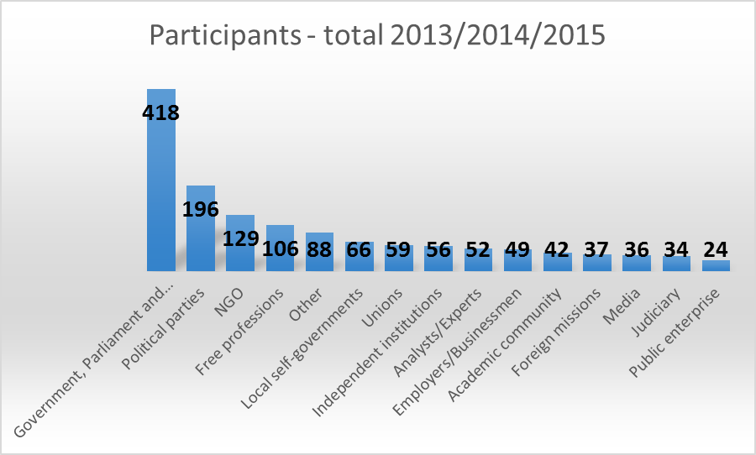
Data processing included the analysis of daily and weekly news-political programmes, classified within the annual reports of Council of RTCG as an integral part of news programme of Television of Montenegro or Dnevnik 2, U centar, Okvir, Otvoreno, Replika, Izazov, Robin Hud, Intervju s povodom.
Data processing did not include shows Mehanizam, because it is the case of specialised programme of investigative character, nor Putevi života, because the majority of episodes were in the form of reports.

Slide 5
Law on Electronic media, Official Gazette of Montenegro 46/2010
Law on Public Broadcasting services „Radio of Montenegro” and „Television of Montenegro“, Official gazette of Republic of Montenegro 51/2002
Law on Media, Official Gazette of Republic of Montenegro Gore 51/2002
Statute of RTCG

Slide 6
2013
During 2013, Montenegro held presidential and series of local elections which RTCG covered in line with the Rules adopted by the Council of RTCG. Progress was noticeable in terms of the production and organisation, and in the enhancement of programme formats during the course of presidential elections in 2013, with the presidential debate as the jewel in the crown. Though it was produced and organised based on the example of quality informative-political redactions, one could have noticed significant limitations in journalistic part of the job. Namely, subjects imposed by the RTCG indicated on basic lack of knowledge on the competencies of president of state, hence during the debate, candidates spoke about the things which the president of state formally cannot conduct, thus leaving the citizens without an objective information. For instance, one of the topics during the debate was the economic development of Montenegro, even though this does not fall under the competency of president according to the Constitution of Montenegro.

Slide 12
Five most frequent interlocutors in political-news shows - U centar, Okvir, Replika and Izazov - in 2013. were During the process, we did not account the final sum of guests from shows Otvoreno and Robin Hud:
Srđan Milić – SNP (4)
Aleksandar Damjanović – SNP (4)
Rade Krivokapić – Union of KAP (4)
Andrija Mandić – DF (3)
Darko Pajović – Positive Montenegro (3)
Damir Šehović – SDP (3)
Nebojša Dožić – representative of Government in the Committee of KAP
Zoran Masoničić – SSCG (3)
TOP 10 compared to the number of interlocutors and compared to the number of shows | DPS
 | SNP
 | Ministry of Education
 | DF
 | General and specialised hospitals
 | Basic court
 | Employers Union
 | Ministry of Health
 | Positive Montenegro
 | Ministry of Agriculture and Rural Development

Slide 13
2014
2014 was marked by local elections in Ulcinj (January), then in Berane (March), and in May in Podgorica, Bar, Bijelo Polje, Danilovgrad, Žabljak, Kolašin, Plav, Plužine, Pljevlja, Rožaje, Šavnik, newly formed municipality of Gusinje, and city municipalities of Golubovci and Tuzi.
RTCG covered them through three debates, electoral night and regular news shows, all in the total duration of 914 minutes. Debates on public broadcaster were organised by respecting the form prescribed by the rulebooks. In that regard, the organised debates presented a practical quoting or paraphrasing of written programmes of electoral lists, without the essential review on real problems which citizens of local self-governments face, therefore without the dynamics which catches the eye of viewers and provides new information.
.

Slide 18
Five most frequent interlocutors on political-news shows - U centar, Okvir, Replika and Izazov – in 2014. were:
Srđan Milić – SNP (3)
Mladen Bojanić – Positive Montenegro, later an independent MP (3)
Snežana Jonica – SNP (3)
Petar Ivanović – then Minister of Agriculture and Rural Development (3)
Duško Marković – vice president of Government(3)
Srđa Keković – USSCG (3)
Gordana Đurović – Faculty of Economy/UOM (3).
TOP 10 compared to the number of interlocutors and compared to the number of shows | DPS
 | SNP
 | Ministry of Health
 | DF
 | Ministry of Agriculture and Rural Development
 | Union of Free Trade Unions
 | Positive Montenegro
 | Administration for Inspection Affairs
 | Trade Union States of Montenegro
 | University of Montenegro

Slide 19
2015
Previous year, politically-wise, was marked by protests in the organisation of Democratic Front, with the emphasis on largest protest which was held on 24 October 2015. Reporting of informative programme of RTCG on protests was severely criticised by organisers, but also by independent media, NGOs and other political parties.

Slide 25
Five most frequent interlocutors on political-news shows - U centar, Okvir, Replika and Izazov – in 2015. were:
Ivan Vuković – Faculty of Political Sciences/UOM (8)
Zorica Kovačević – Former Minister of Labour and Social Welfare (6)
Azra Jasavić – Positive Montenegro (5)
Darko Pajović – Positive Montenegro (5)
Zlatko Vujović – CEMI (5)
Snežana Jonica – SNP (4)
Milo Đukanović – Prime Minister (4)
Zoran Vukčević – Investment-Development Fund (4).
TOP 10 compared to the number of interlocutors and compared to the number of shows | DPS
 | University of Montenegro
 | Positive Montenegro
 | Ministry of Labour and Social Welfare
 | Ministry of Tourism and Sustainable Development
 | DF
 | SNP
 | Ministry of Interior
 | Ministry of Foreign Affairs and European Integration
 | Police Department

Slide 26
Conclusions and remarks
During previous three years, majority of appearances on the analysed news shows of RTCG were by far characterised by ruling Democratic Party of Socialists (DPS) and representatives of state institutions. The attempt to monopolise public discourse through public broadcaster is dangerous for every society which strives to turn into a democratic one, and certainly does not contribute in the affirmation of public broadcaster which should ensure the pluralism of opinion and be of equal service to citizens, regardless of whether they support or criticise the government.

Slide 27
Conclusions and remarks
RTCG does not provide equal opportunities when it comes to the availability on political-news shows, in other words, it does not pay attention when it comes to political power of political groups according to their representation in the Parliament of Montenegro and support expressed in public opinion. In three analysed years, with focus on four key shows of such type (U centar, Izazov, Okvir, Replika), Democratic Party of Socialists, (DPS) had 47 appearances, followed by Socialist People’s Party (SNP) with 38 appearances, then by Democratic Front (DF) with 31 appearance, Positive Montenegro with 29.5 appearances and SDP with 12.5 appearances.
The situation is even more radical in terms of the possibility of appearance by some of the representatives of developed, critically-oriented NGOs to express their views on public broadcaster, which is why they suffered the consequences in the form of various types of discrimination and assaults. Thus, collectively for all three years, the majority of appearances on key politically-informative shows (U centar, Izazov, Okvir, Replika) was marked by Montenegrin Tourism Association (CTU) eight times, followed by Centre for monitoring (CEMI) and Civic Alliance (GA) with six appearances, then Consumers protection Center Montenegro (CEZAP) with four appearances and NGO Alfa centre with three appearances.
Political parties (total 2013, 2014, 2015) |  | NGO (total 2013, 2014, 2015) |  | TOP interlocutors (total 2013, 2014, 2015)
DPS | 47 | CTU (Montenegrin Tourism Association) | 8 | Srđan Milić | 10
SNP | 38 | CEMI | 6 | Snežana Jonica | 9
DF | 31 | Civic Alliance alijansa | 6 | Darko Pajović | 9
Positive Montenegro* | 29.5 | CEZAP | 4 | Azra Jasavić | 8
SDP* | 12.5 | Alfa centre | 3 | Aleksandar Damjanović | 8
Shows: U centar, Izazov, Okvir, Replika |  |  |  | Ivan Vuković | 8

Slide 28
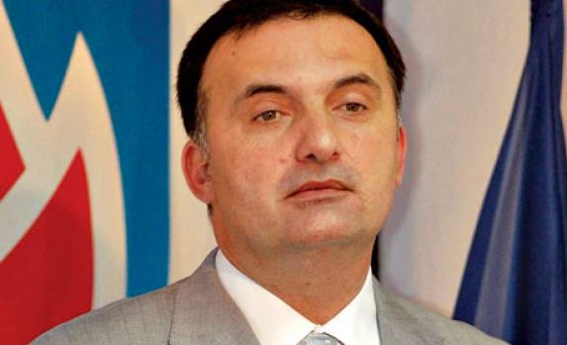
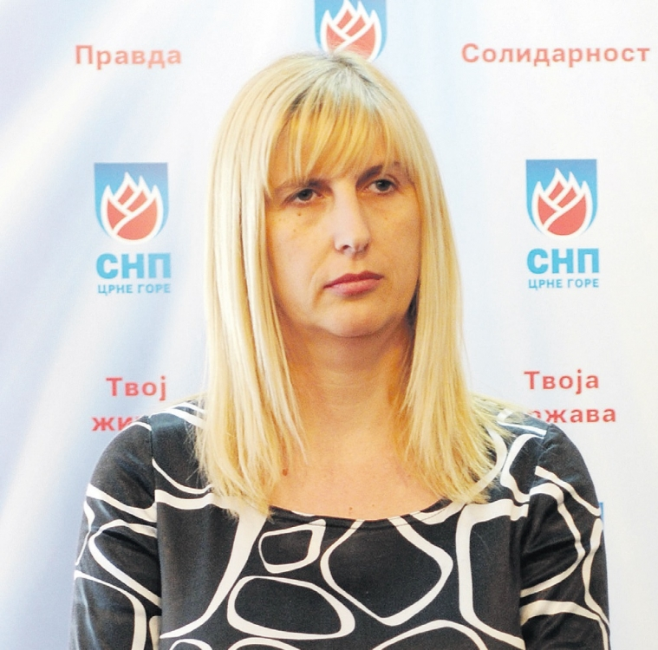
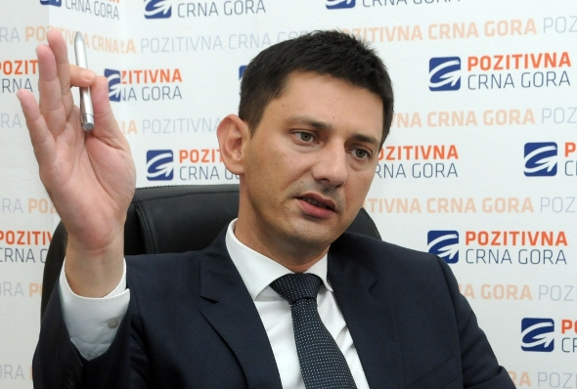
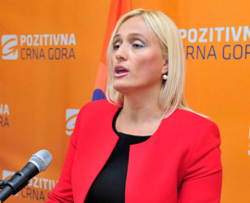
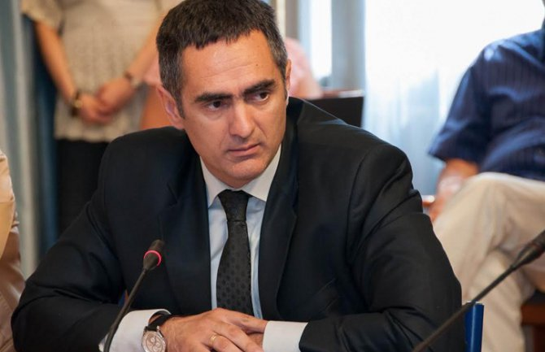
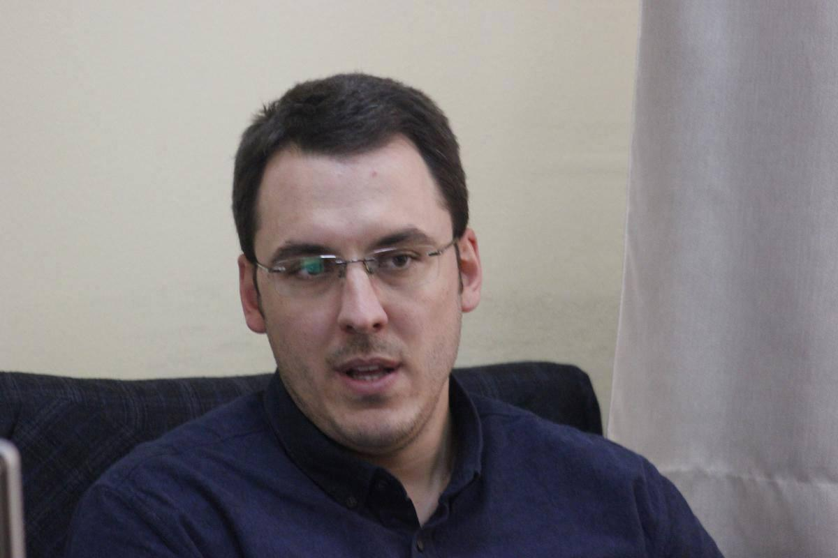
10
9
8

Slide 29
Izazov
By examining the shows, most drastic example of unbalanced selection of guests was on the show Izazov, by Isidora Šoć Sekulić, which focuses on (Euro) Atlantic integration.
The editorial staff of this show apparently favours that option which is prone to the accession of Montenegro to NATO, with a subsequent host of pro-NATO interlocutors.
More precisely, out of 106 guests during 2014 and 2015, CCE’s analysts identified only eight (8) interlocutors who advocated the stance that Montenegro should not join the NATO alliance or 7.55%.
Some of interlocutors were repetitive, by appearing four or five times, while there was a ton of others who were not able to express their opinion on this matter even though they represent significant social factors in Montenegro (in terms of diversity, there was a total of 75 interlocutors).

Slide 30
U centar
In line with formal division on government/opposition, the selection of interlocutors on the show U centar, by Andrija Nikolić, seems fair. However, once we analysed the structure of interlocutors, it was clear that it did not reflect the power expressed in mandates in the Parliament of Montenegro or according to available ratings of political parties.
Also, this show clearly ignored the representatives of SDP, except for the participation of president of council of SDP Jusuf Kalamperović in 2014.
Out of 134 guests in total, during the period 2013-2015, CCE’s analysts noted the participation of 69, or 51.49%, representatives of government and state institutions, as well as them-related subjects in the assessment of developments in the state, then 47 participants, or 35.07%, from the ranks of oppositional parties or those who are somewhat more critically-oriented towards the authorities (mainly the representatives of Positive Montenegro and SNP with almost half of the appearances), and 18 interlocutors, or 13.43%, who are from region or provided somewhat more neutral opinion.
Key interlocutors of Andrija Nikolić in past three years, were: Darko Pajović, president of Positive Montenegro with seven appearances, Srđan Milić, president of SNP, Milo Đukanović, Prime Minister of Montenegro and Andrija Mandić, member of presidency of DF with five.
This show collectively had 94 interlocutors in three years, with some of them who were more frequently invited on the show than others.

Slide 31
Okvir
On the show Okvir, by Zoran Leković, during previous three years, or from 2013 to 2015, there were noted 346 appearances, while the actual number of interlocutors was 227 because some appeared several times on the show.
government and ruling parties were represented with 46.53%, and opposition with 13.87%, whereby on this show we recorded great number of those (39.60%) who belong to other social spheres and have different relations with government and opposition (unions, economy, analysts, academic community, and etc.).
Even though this show, according to the official documents of RTCG, is defined as a show which deals with socioeconomic issues, it is evident that some other issues were in its focus as well, which is why it sometimes interlaced with other shows in terms of topics and guests
Most frequent interlocutors of Zoran Leković were: Aleksandar Damjanović, president of the Committee for economy and SNP official, Damir Šehović, member of the Committee for economy and vice president of Social-Democrats (previously an official of SDP), Zoran Vukčević, DPS official and director of Investment-development Fund (IRF) and Snežana Jonica, SNP official with six appearances each, followed by Srđa Keković, general secretary of Union of Free Trade Unions and Suzana Radulović, general secretary of Employers Federation with five appearances each. Vasilije Kostić, economy analyst, Vukica Jelić, former director of Employment agency, Zoran Jelić, DPS official, Srđan Milić, president of SNP, Petar Ivanović, former Minister of Agriculture and Rural Development, Milan Lakićević, former director of Tax Administration, Zorica Kovačević, former Minister of Labour and Social Welfare, Žarko Radulović, president of Montenegrin Tourism Association, and Rade Krivokapić from Union of KAP who appeared four times each.
though previously envisaged as a debate-based show, we recorded 15 interviews, with distinct imbalance in the representation of interlocutors, i.e. dominant presence of members of Government, managers of state, public or independent institutions, as well as of local self-governments and them-related persons, with the exception of one guest from the academic community and one from region. In this regard, most frequent interlocutor in the form of interview was Petar Ivanović, former Minister of Agriculture and Rural Development, who was invited for four interviews, or half of those who were with ministers in the Government of Montenegro, or more than a quarter of all the interviews.

Slide 32
Replika
During two seasons, in 2014 and 2015, the author of show Replika, Nevenka Ćirović, had 144 guests in the studio, or 124 different interlocutors given that some of them appeared more times on the show.
Out of that number, according to findings of CCE, they were 22.22% representatives of opposition, 35.42% of government and ruling parties, and 41.36% of those who belong to other social structures and whose positions were closer or farther in relation to government or opposition.
In the case of oppositional structures, this show was also mainly characterised by the representatives of SNP and Positive Montenegro, but unlike other informative-political shows, Replika had better balance in the case of Democratic Front.
Most frequent interlocutors in Replika were: Snežana Jonica from SNP, Boris Raonić from Civic alliance, Slaven Radunović from DF, Ranko Đonović, former president of LSCG and Mili Prelević, journalist of «Daily papers» who appeared three times each.
Primjetno je i da od deset gostovanja predstavnika/ca nevladinih organizacija, u 2014. i 2015. godini, 50% ide na Građansku alijansu dok je ostalih pet gostovanja podijeljeno na pet različitih NVO.
Also, the same “line-up” which analysed the congress of SDP and DPS, appeared two times on the show.
Finally, even though this was originally designed as dialogue-based show, an interview was done once in 2015 with the president of Montenegro Filip Vujanović.

Slide 33
It was not until 2015 that the editorial board decided to open the doors for certain critically-oriented NGOs (for instance, MANS, CCE, IA) whose project activities are recognised in Montenegrin and international public, which improved that part of the «statistics». Appearances were mainly realised within the show Otvoreno, through joint project of OSCE Mission to Montenegro and RTCG, but within one context which was very limited clock-wise and controlled in terms of the majority of non-critically-oriented guests, hence it was hard to see a substantiated debate in which the participants have equal opportunities. Hence, we got the impression that this was more a matter of project task rather than change of editorial policy.
On the other hand, in the extent in which there is an interest for topics on local level, indicating that it is not sufficiently emphasised, TVCG had a balanced approach in the representation of interlocutors from municipal administrations, regardless of whether the municipalities were ruled by the ruling coalition or opposition, reminding that CCE did not analyse the content of those appearances. Also, the approach is unequal in the case of unions, whereas that was not the case with universities where the interlocutors mainly were from the University of Montenegro. It is important to mention that, even though they are represented as employees on the University of Montenegro, many interlocutors in analysed shows appeared in the capacity of experts in their areas, meaning that higher education essentially stays out of the thematic focus of public broadcaster RTCG.

Slide 34
Analysed annual reports on the realisation of programme orientation of TVCG for 2013, 2014 and 2015 contain mostly the same content, written according to an established matrix, with the mechanical alteration of data. Often they contain identic paragraphs, without the clarification as to why there was no progress in identified problematic areas, or an indication that they approached to determine the accountability on any ground.
What is of concern is that the management of TVCG does not recognise the weaknesses in its informative programme despite numerous critics from its citizens, independent institutions, opposition, but also from certain members of Council which continually and substantially indicate on deficiencies. Management of RTCG defines mostly the issues of technical and production nature as its weakness, and avoids the essential analysis of programme content.
RTCG often deviates from the adopted programme scheme, or that they ad hoc change the thematic focus of the shows or the format, which is why sometimes there is an overlap in short period of time in terms of the topics and guests on RTCG. In that sense, it would be good if there were more clear and binding guidelines for authors so that they could cover greater number of topics and include more diverse interlocutors..

Slide 35
Although there is a separate show Intervju s povodom, it is rarely broadcasted. However, it was noticed that certain shows which are not envisaged as such, broadcast interviews mainly with the officials of executive government or ruling parties, without a clear cause, which is why it looks like RTCG is favouring these structures.
Centre for Civic Education (CCE) hopes that recent changes, as well as those that are yet to come, in the managing structure and informative programme will contribute in further democratisation and enhancement of openness of RTCG, which unfortunately still does not present the media which adequately pays off what tax payers invest in it, regardless of their beliefs or affiliations.

